Slide 1

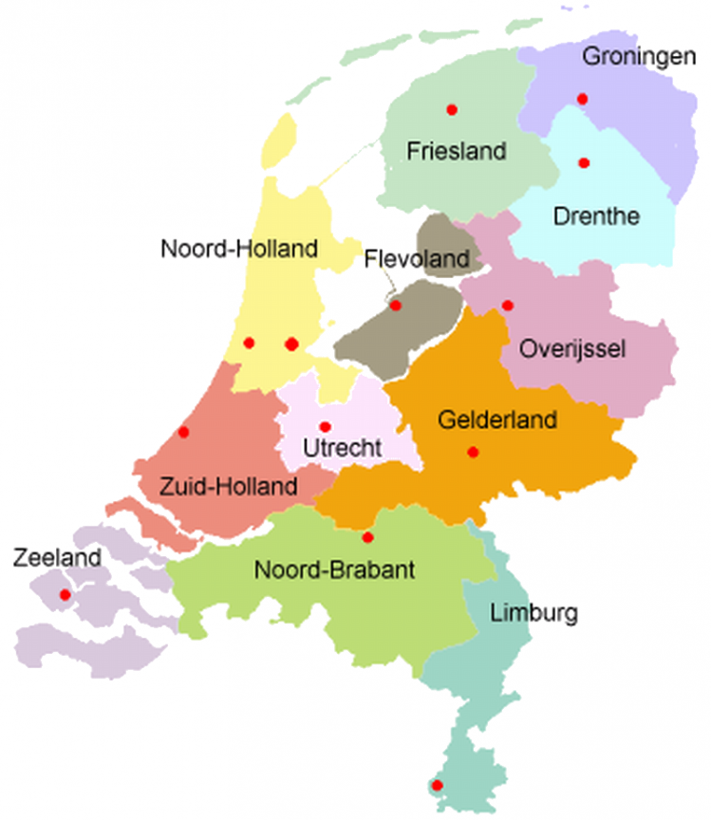
Data Science in Energy Systems Modelling Assignment 04
Netherlands
Group E
Fahad Shakeel
Notes:
1

Slide 2
Table of Contents
Introduction
Land Eligibility Analysis
Power Plant Capacities
Investigations
Outcome
Notes:
2

Slide 3
Introduction

Slide 4
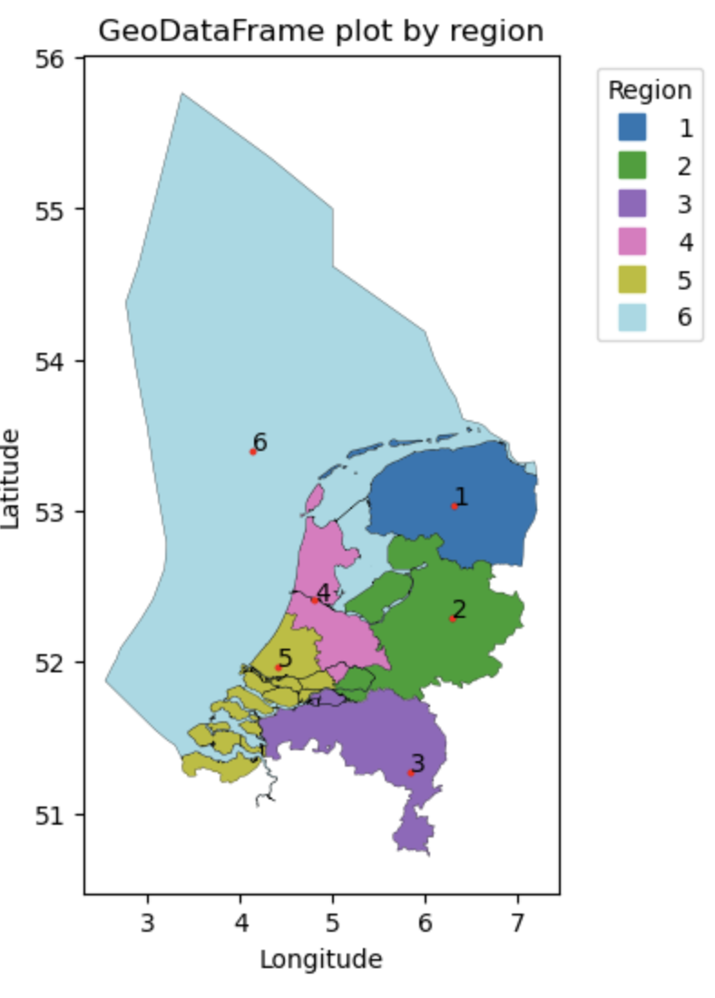
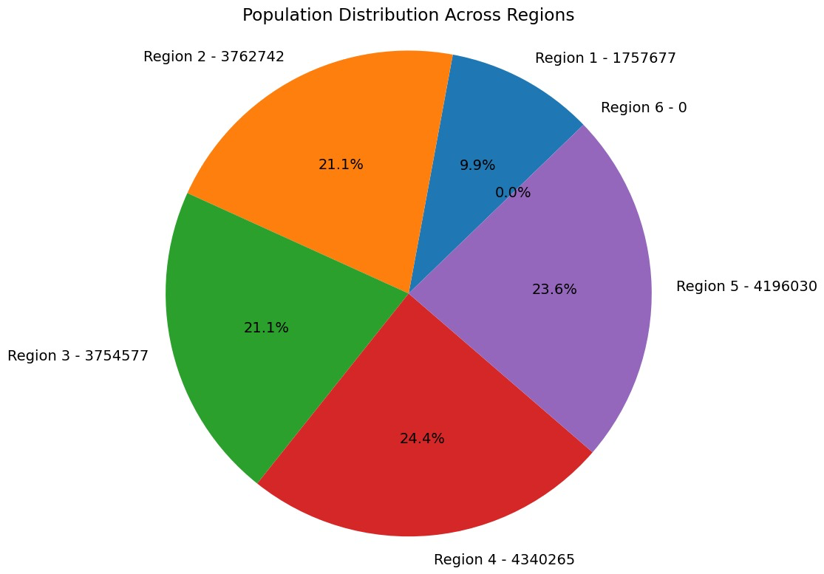
Regional split with populations
Total Area : 41,850 km²
Population : 17.7 million

Slide 5
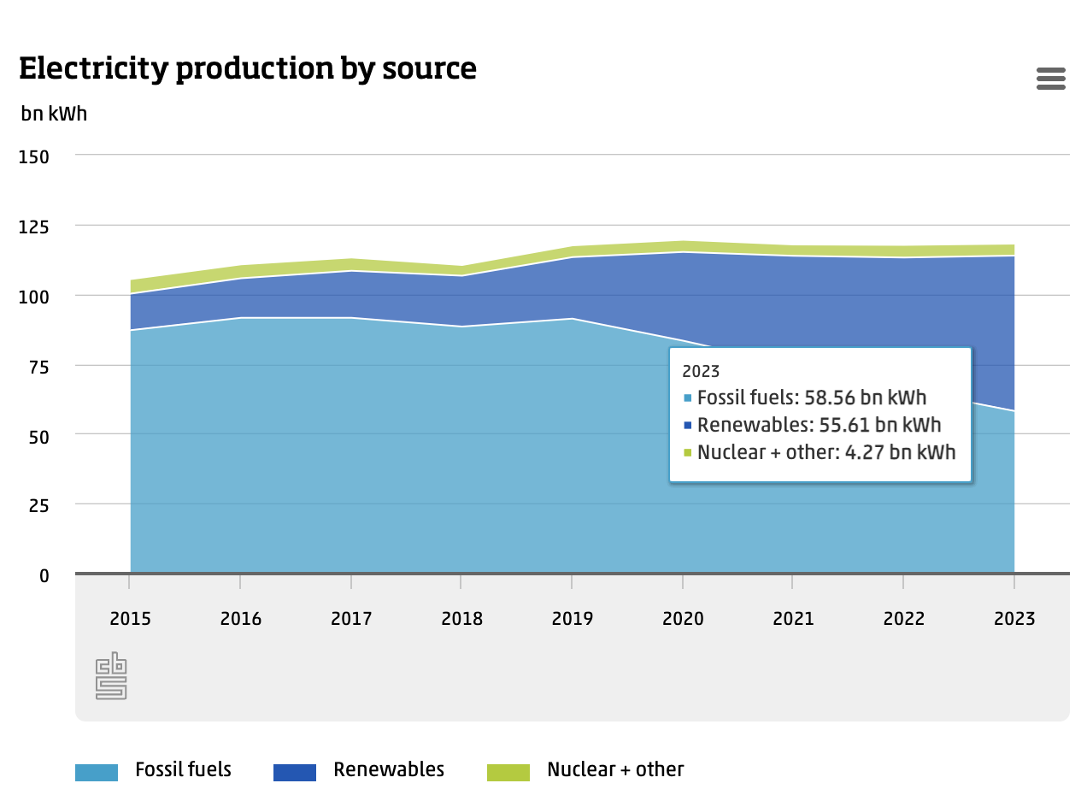
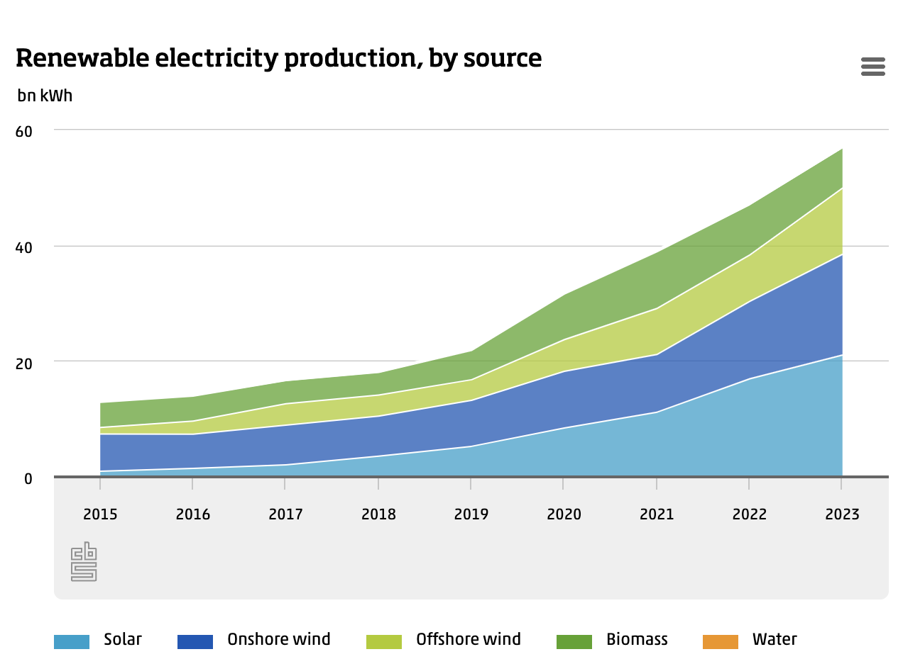
In 2023, 48 percent of electricity was generated from renewable sources such as solar, wind and water.
Between May and July, over half of the electricity generated in the Netherlands was from renewable sources, and that share reached as high as 57 percent in July.
Production from renewable sources increased by 21 percent in 2023 compared with the previous year

Slide 6
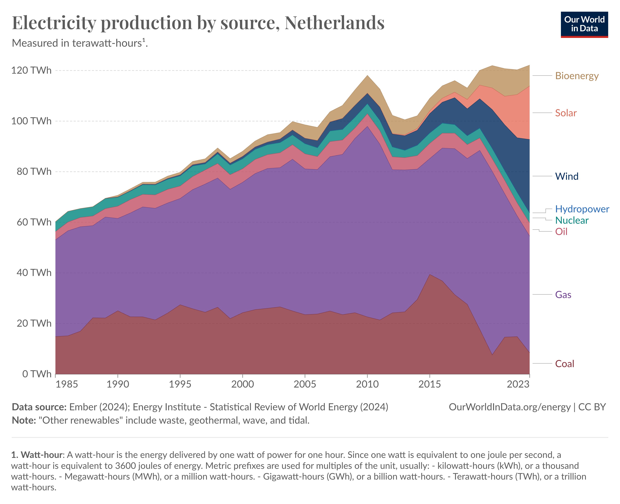
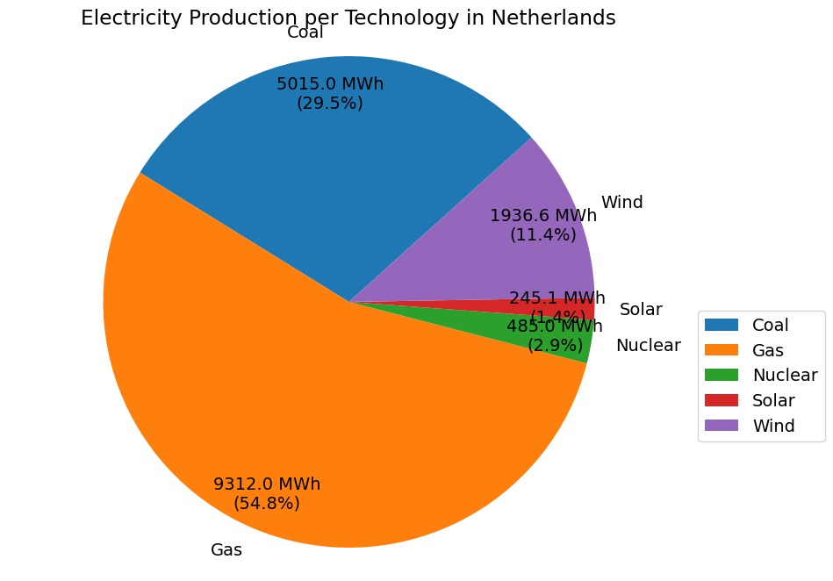
Electricity Mix
Electricity generation
Total energy supply (TES) by source, Netherlands 1985-2023

Slide 7
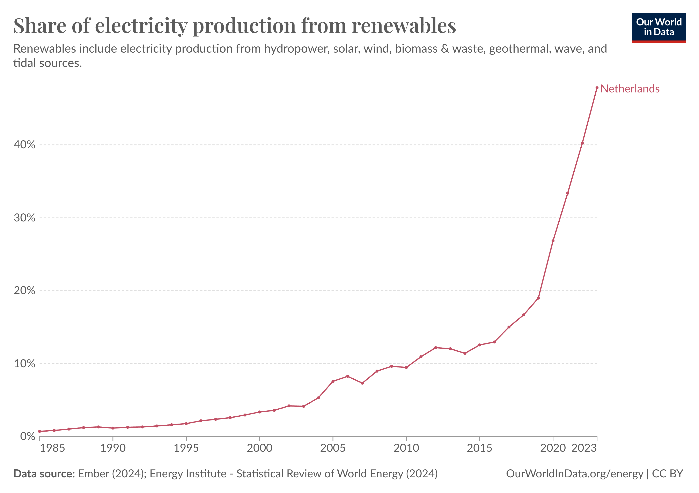
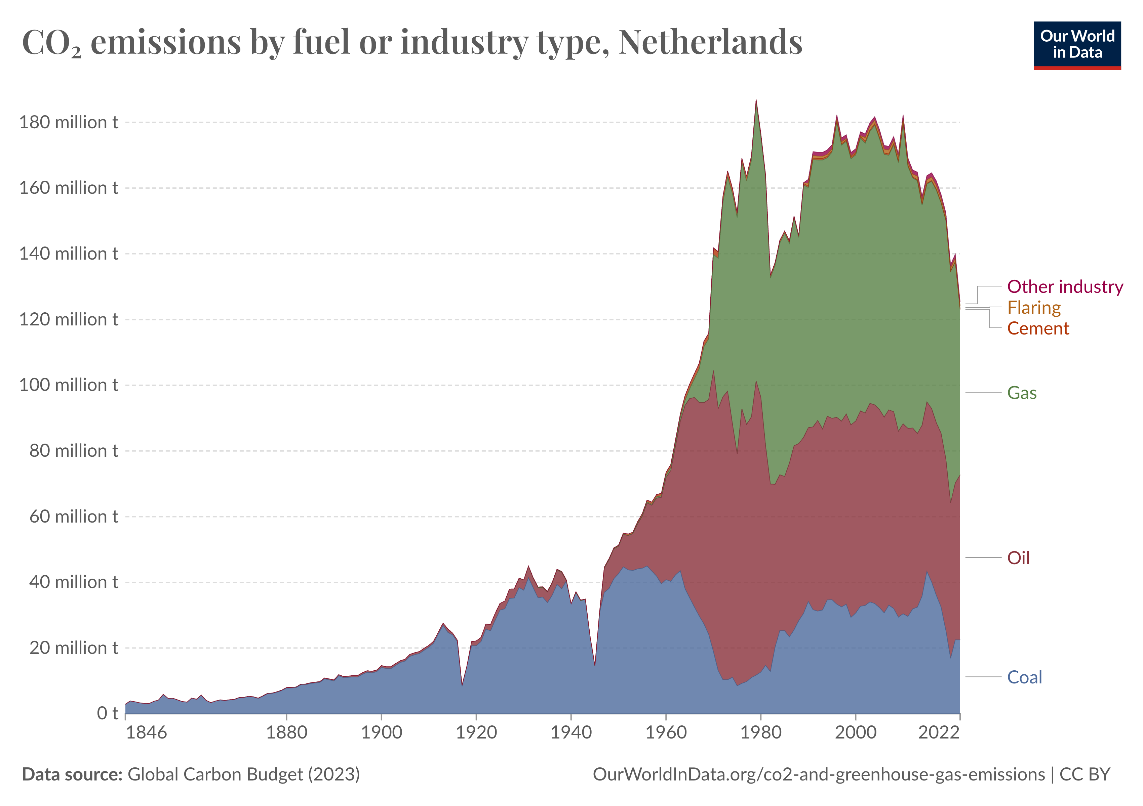
Renewable Share & CO₂ Emissions
Renewable Share
CO₂ emissions by energy source

Slide 8
1. Land Eligibility Analysis

Slide 9
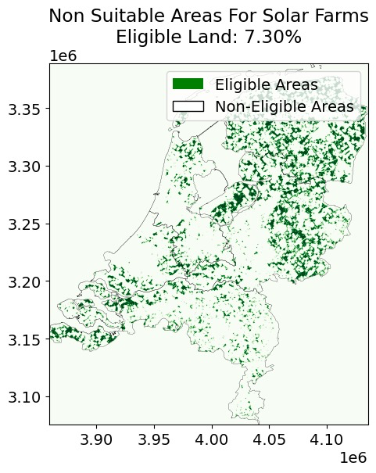
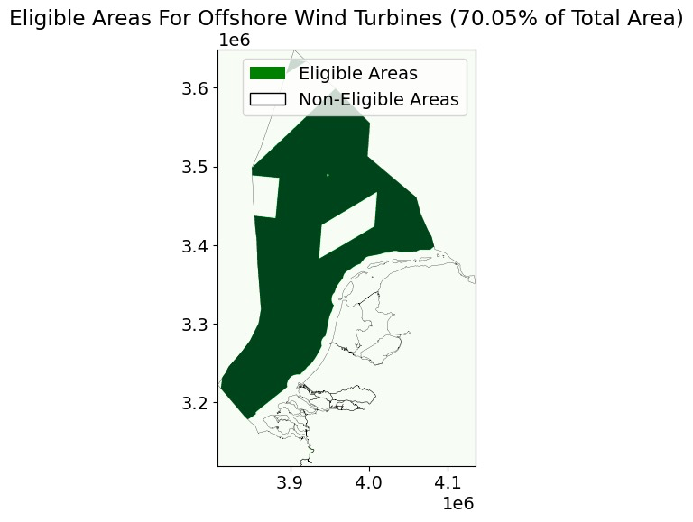
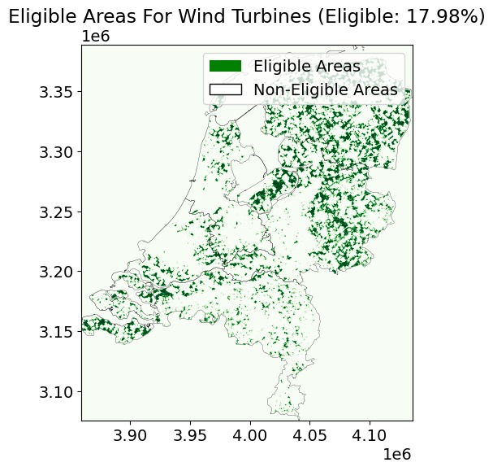
Available Areas for Installation

Slide 10
2. Power Plant Capacities

Slide 11
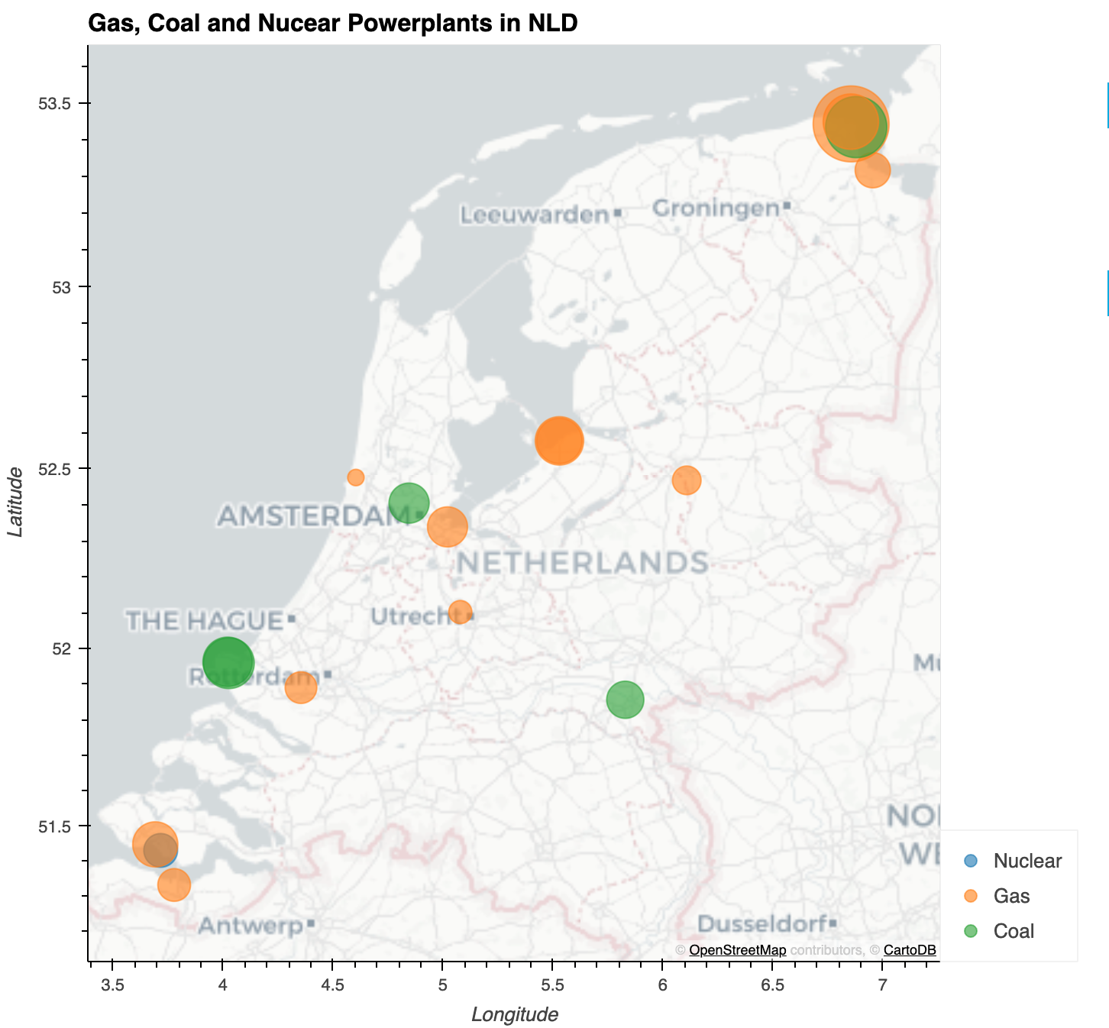
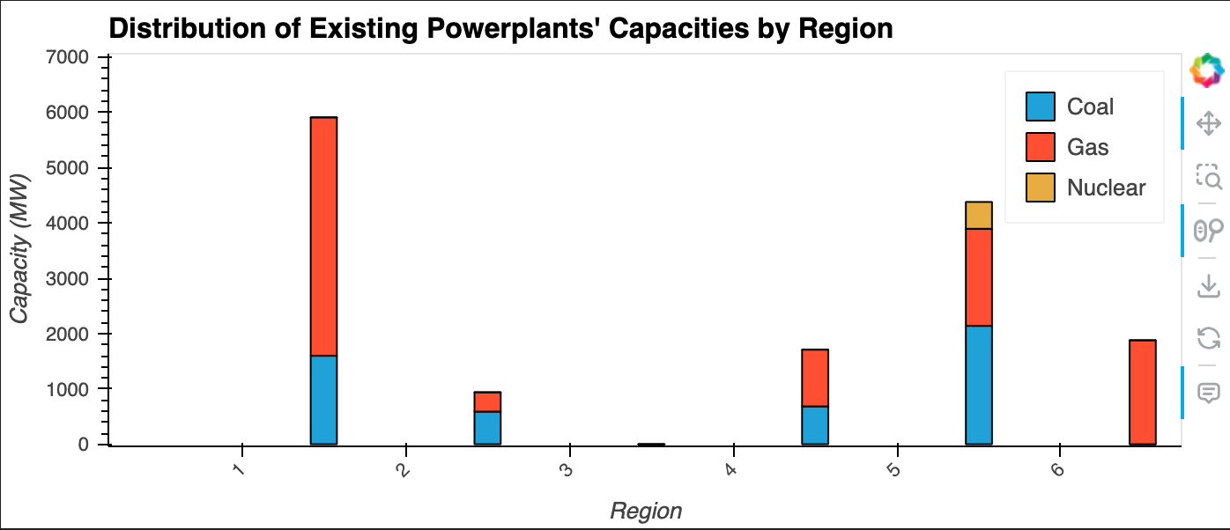
Current Power plants Capcacities

Slide 12
3. Load Time Series and Regional Distribution

Slide 13
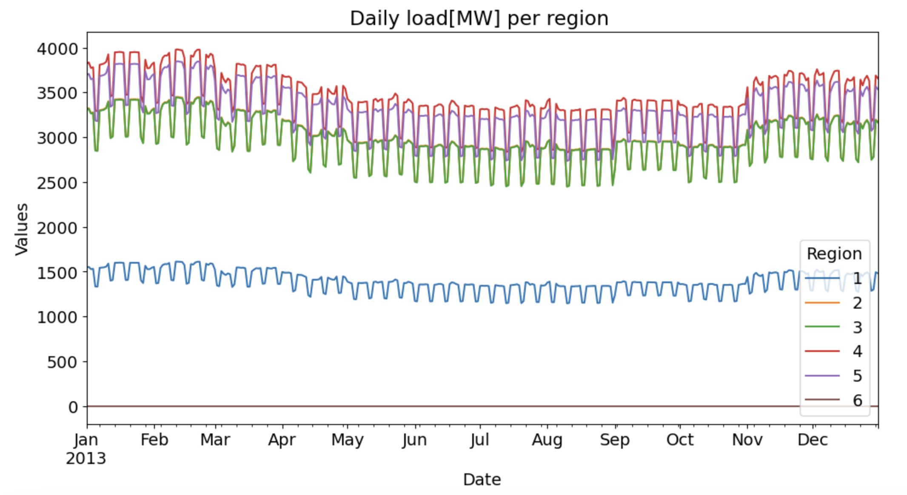
Load time series
Region 4 has the highest demand followed by Region 5 and 3
However, All the regions have similar load profiles meaning they are peaking around the same time of the year
Region 1 has fairly constant load profile

Slide 14
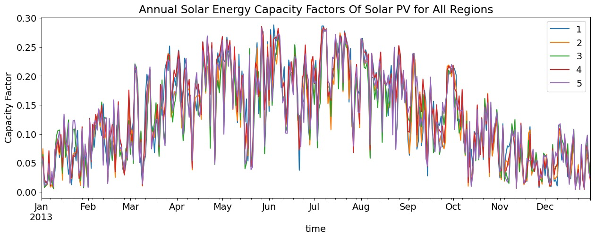
CF for PV Solar
PV Solar
The highest capacity factors are observed during the summer months, indicating that solar PV systems perform best during this time due to longer daylight hours and higher solar irradiance.

Slide 15
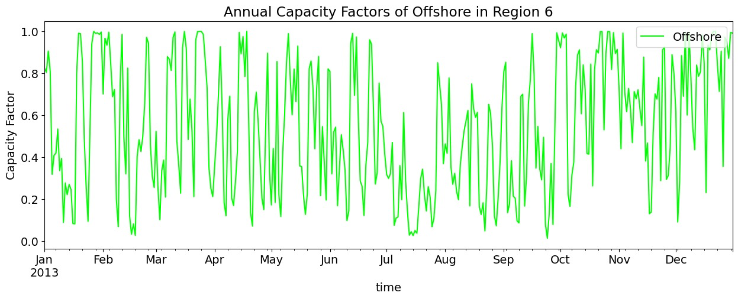
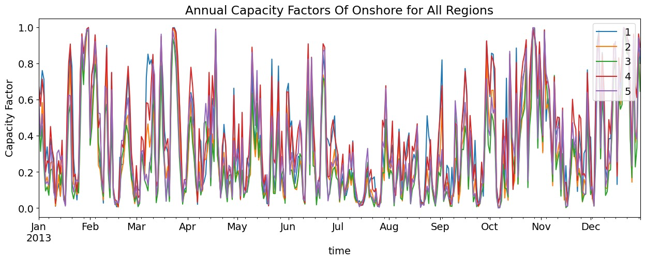
Capacity factor time series
Off-shore wind
Onshore wind

Slide 16
Outputs of interest

Slide 17
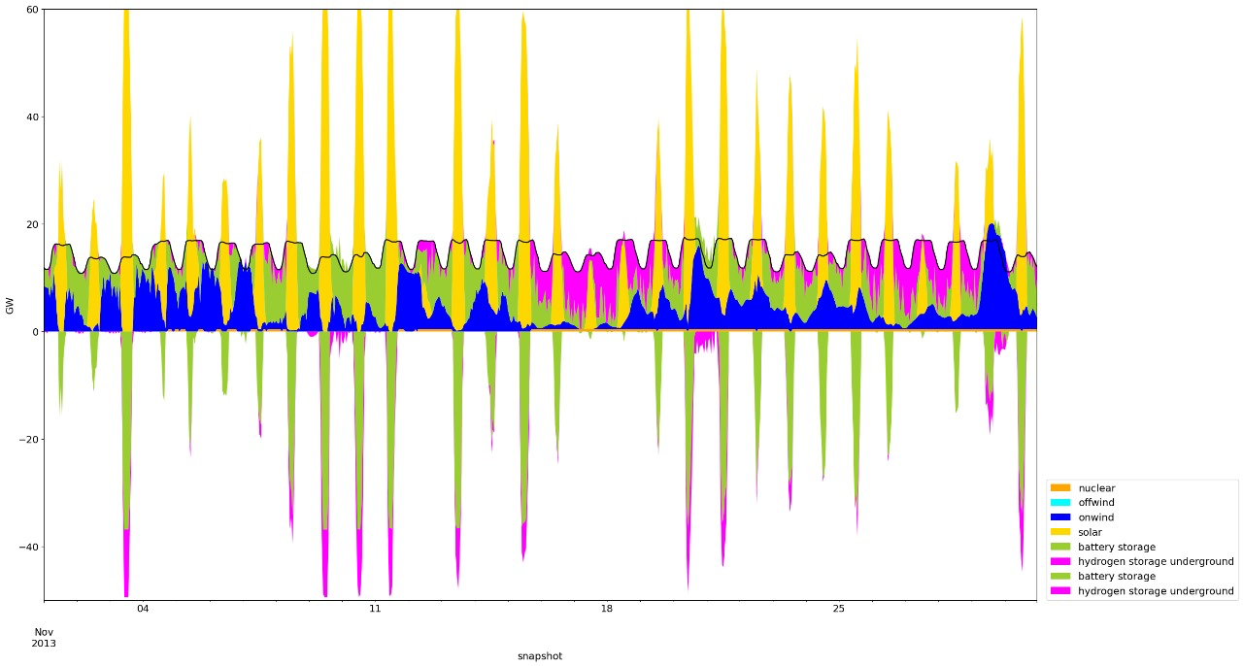
Optimized dispatch with Zero Emissions
Strong Variability: Significant fluctuations in energy production and storage are evident, with frequent peaks and troughs indicating the variable nature of renewable energy sources.
Storage dependence: Negative values indicate substantial reliance on battery and hydrogen storage to manage periods of low renewable energy production and to balance the grid.

Slide 18
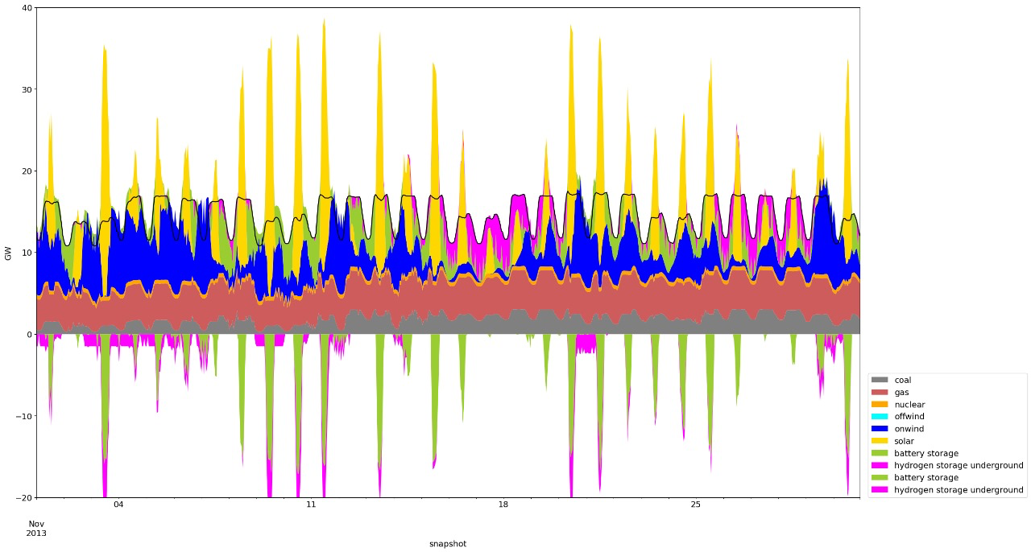
Optimized dispatch with CO2 Emissions
Reduced Variability: The presence of coal and gas reduces overall variability in energy production, leading to a smoother and more consistent energy supply.
more diverse energy mix.
Easier Grid Management with fossil fuel providing stablility

Slide 19
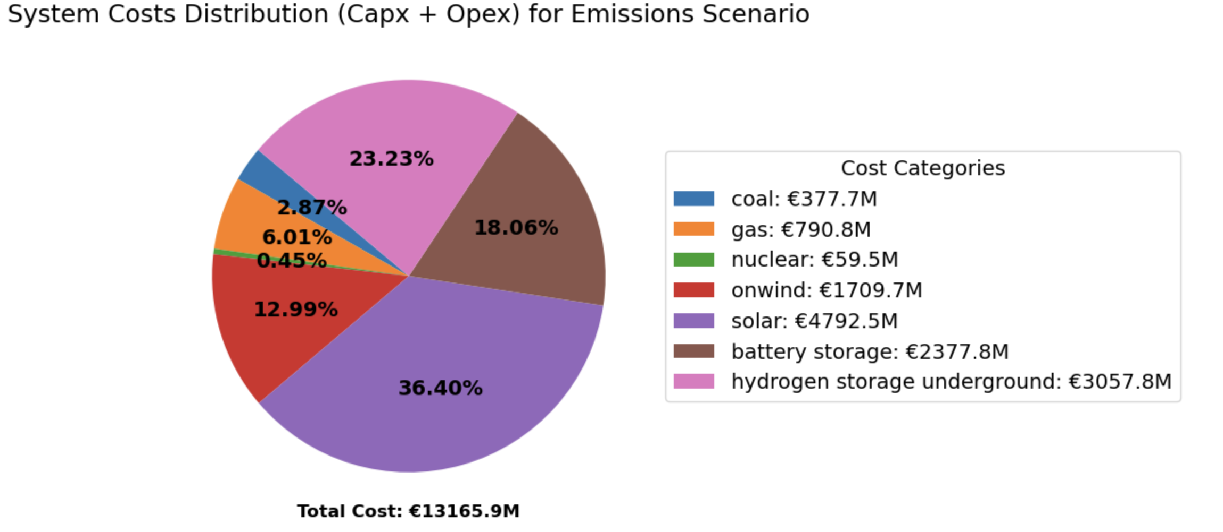
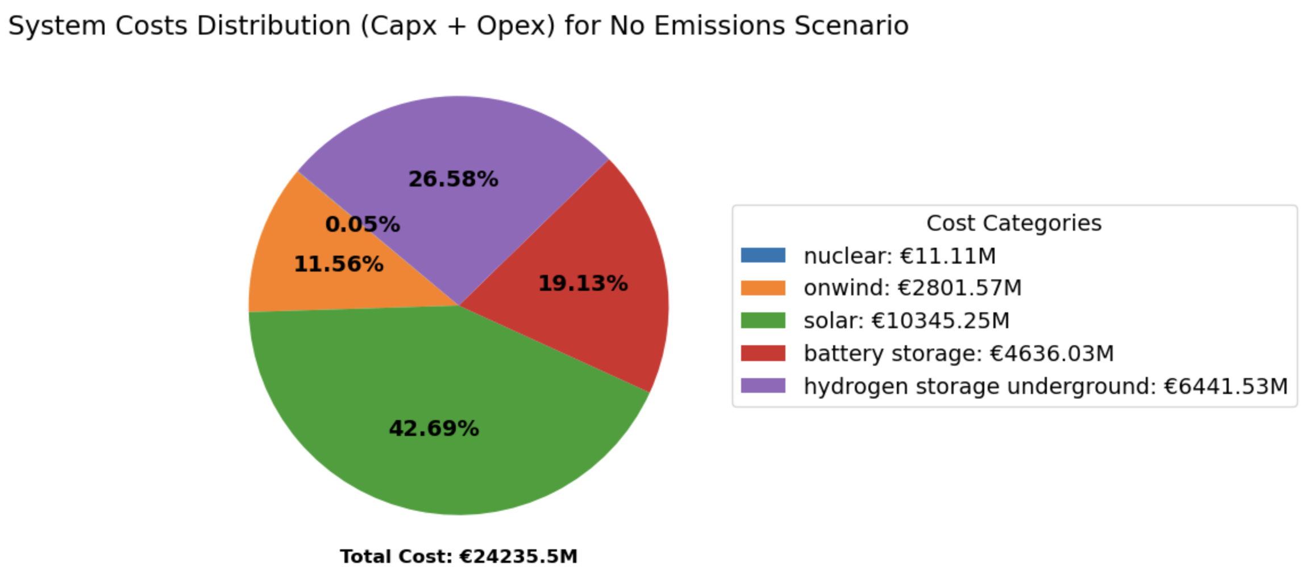
System costs

Slide 20
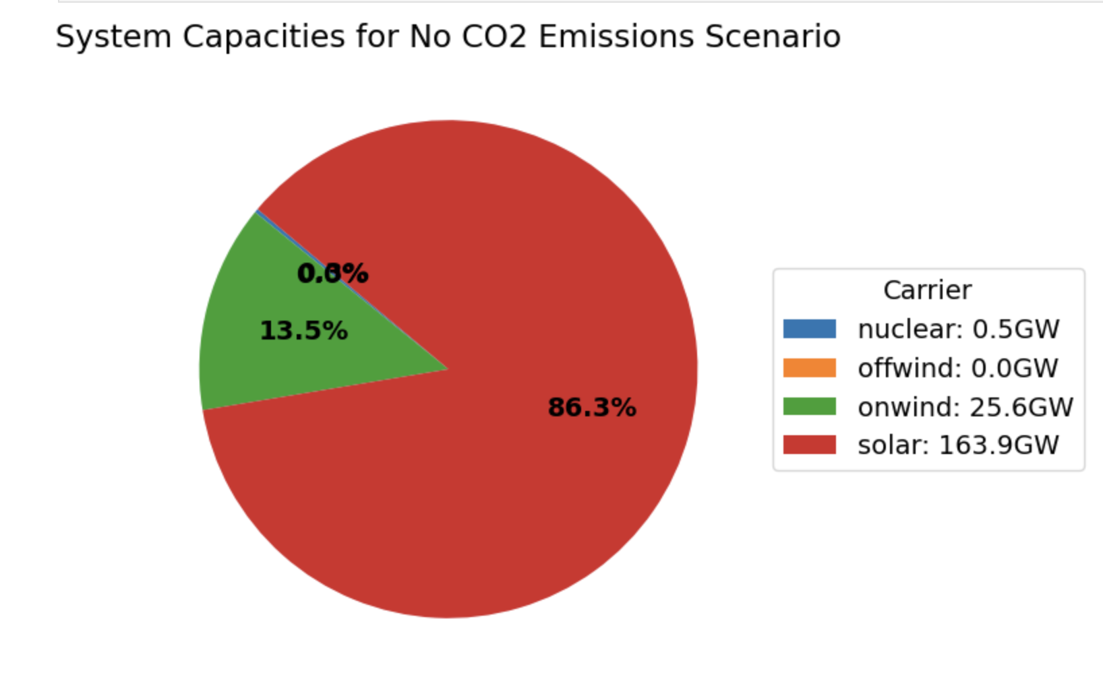
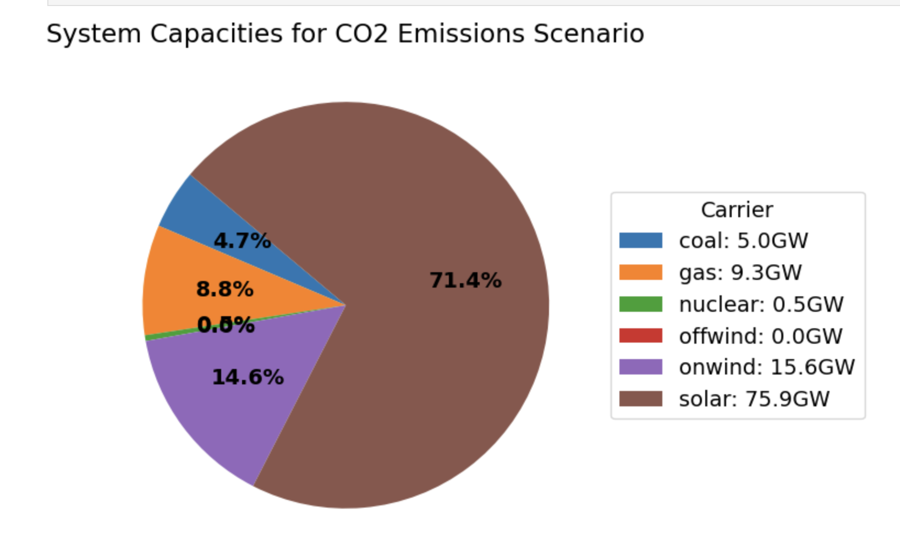
System capacities

Slide 21
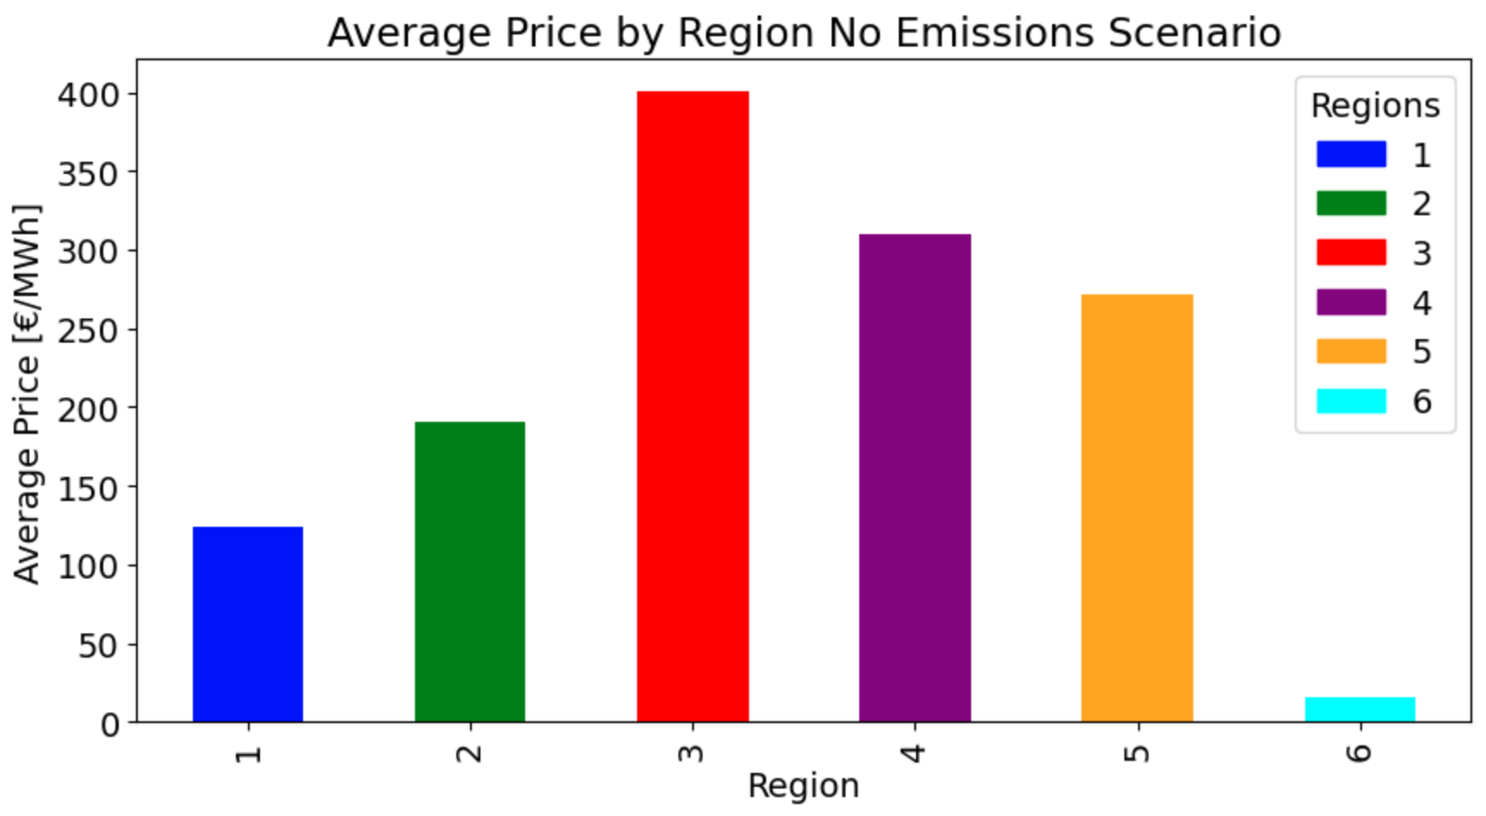
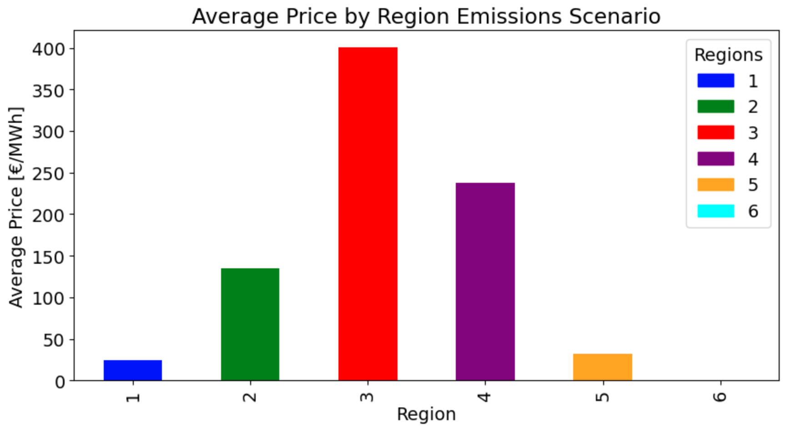
Average Electricity prices per Region
Region 3 has the highest average electricity price because of no existing power plants present in the region and we will incur more transmission cost to supply electricity.

Slide 22
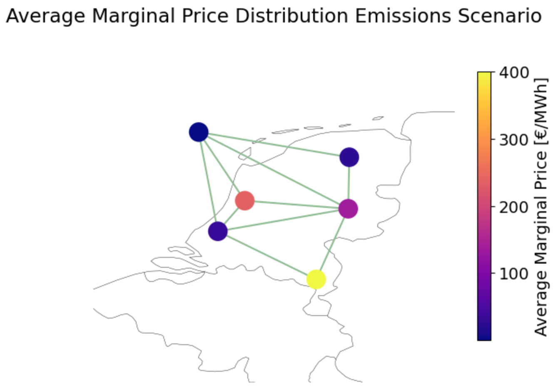
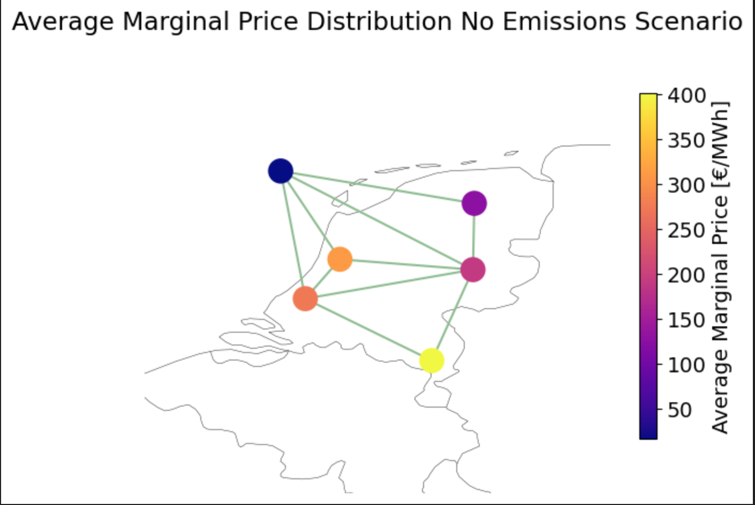
Marginal Prices Distribution

Slide 23
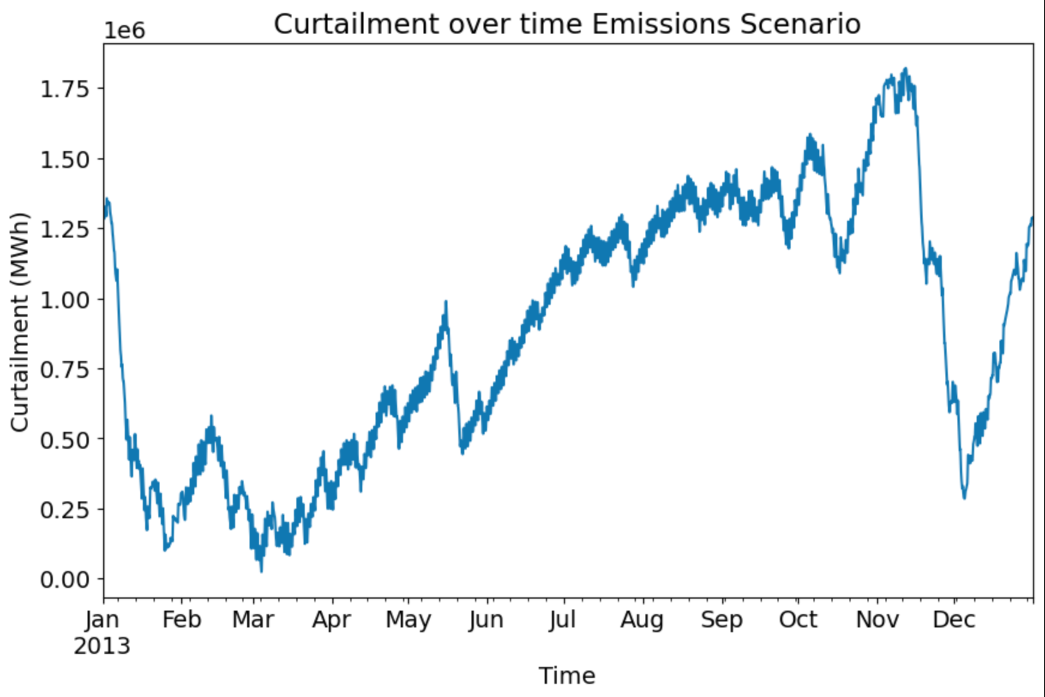
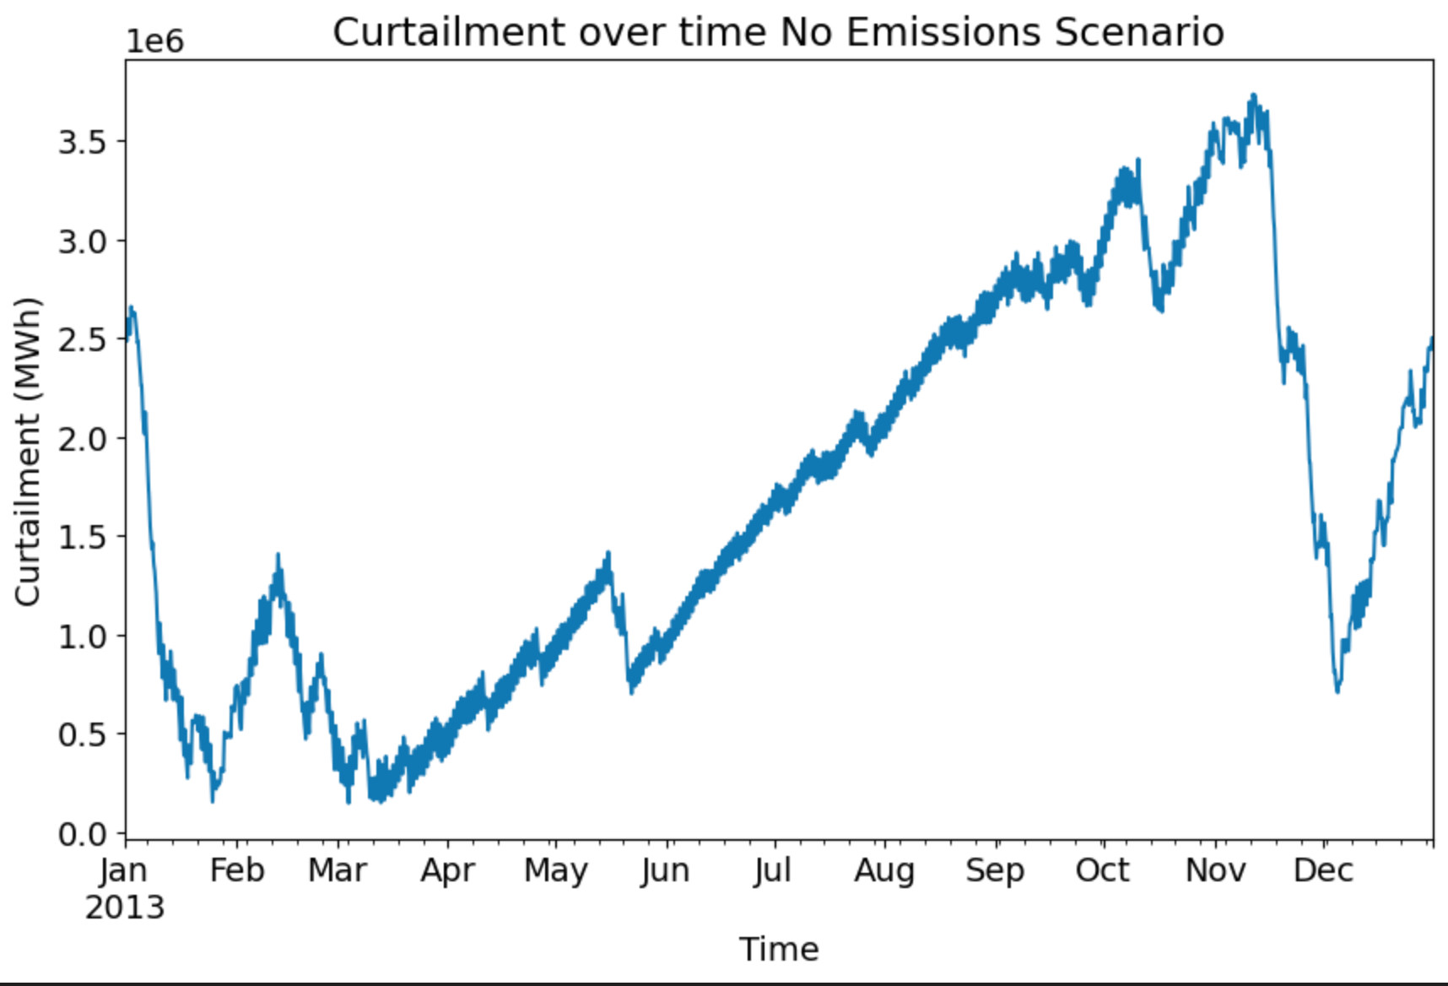
Storage filling levels for each region
With CO2 emissions
Without CO2 emissions

Slide 24
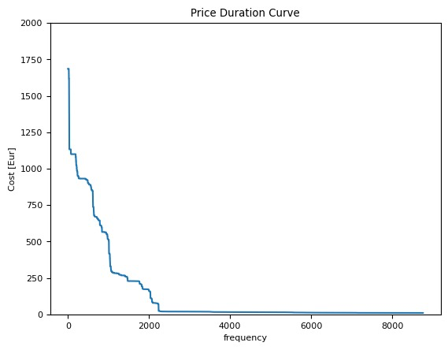
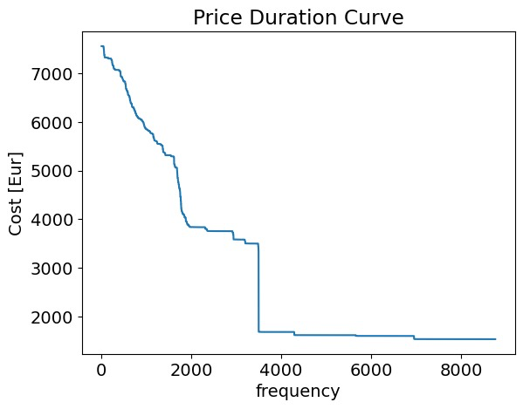
Price Duration Curves
No Emission Scenario
With CO2 emissions

Slide 25

Thank you!

